Slide 1
Using OneNote to create flexible assignments

Slide 2
What is OneNote
Note taking software
Part of MS Office 365 suite
Available on mobile devices, online and laptop/desktop computers
DEMONSTRATION
Notes:
Demonstration covers the basic idea – how it’s used, web clippers, mobile devices
CHECK INTERNET SPEED

Slide 3
Class Notebook
A way to invite many people (e.g. students, lecturers) to share one Notebook
Content area
Collaboration area
Personal area
DEMONSTRATION

Slide 4
How to use it
Deploy content
Deploy study tasks
Review
Provide feedback
Notes:
Use discussion 1 from DACP1002 as example of reviewing student work.

Slide 5
Flexible assessment
The FASTECH approach
Fast: using readily-available technologies; quick to learn, easy to use
Efficient: after start-up period; saves time & effort (paper), productivity
Effective: brings significant learning benefit to students, pedagogic impact
Jessop, T et al., 2011
Notes:
Discuss each of these

Slide 6
OneNote and FASTECH
The assessment is portfolio based which is worked on throughout the whole module – no final deadlines, continual effort
Lecturer friendly: lightweight, quick process for looking at and commenting on student work
Fast, directed feedback; feedback becomes part of the process
Flexible layout encourages creativity in addressing assignment
Peer review
Can work remotely, including remote collaboration
Notes:
Other advantages

Slide 7
3rd party Findings
US University* used OneNote for anatomical education
Students (n=90) were trained
Initially skeptical, steep learning curve
97% reported intent to use this (88%) or similar tools (9%) for the remainder of their studies
Many reported increased efficiency and organisational skills
Notes:
A. T Still University

Slide 8
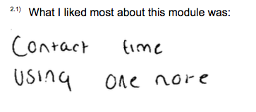
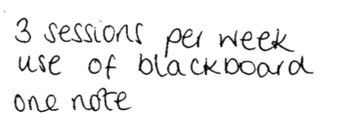
Our findings
Students (n=26) were trained
Initially skeptical
Many ”teething” problems but no steep learning curve
Students were innovative with the use
Anecdotally many (around 40%) said they planned to carry on using OneNote for their studies
Students worried about submission process

Slide 9
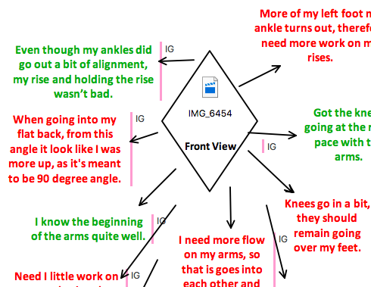
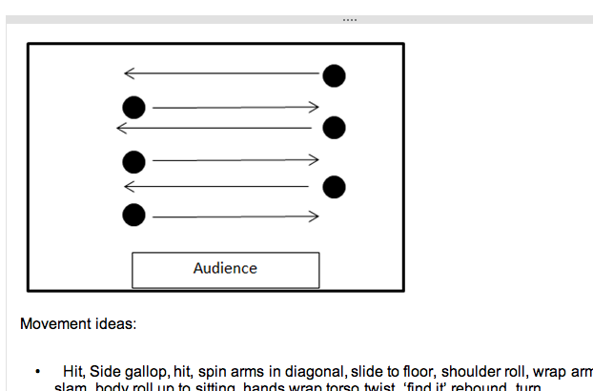
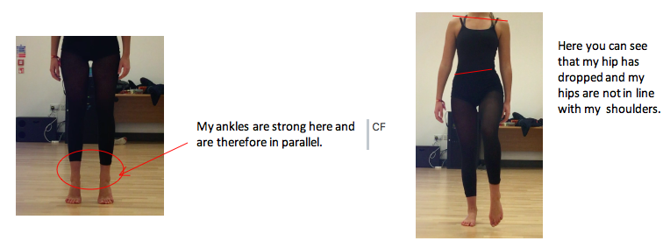

Slide 10
Digital Literacy
JISC model of digital literacy, 2014
Notes:
TODO – practice again

Slide 11
Digital Literacy
I am ... able to see how I could use technology to help me in related situations
I do ... use these notes to make sense of my experiences, collaborate with others and to investigate
I can... use the technology to create media rich notes
I have... access to the technology on all my devices 24 hours a day
Beecham and Sharpe (2010)
Notes:
I have... Access to the technology on all my devices 24 hours a day
I can...use the technology to create media rich notes

Slide 12
Advice for use
Don’t use as a replacement for Blackboard
Do make it as interactive as possible
Begin with structure, allow for experimentation
Share instances of best practice
Don’t embed videos – upload to Office 365 Videos, Vimeo or OneDrive
Would suggest some sort of formal submission event
Issues with personal MS accounts – very clear instruction needed
Training available via Lynda.com/microsoft.com

Slide 13
Future work
We are now looking at using the COLLABORATION SPACE
Sharing
Aims
Ideas
Files
Areas for groups to work in
Multiple people can edit at once
Available offline
Shared todo list
DEMONSTRATION

Slide 14
Questions?

