Slide 1
Using Animated Video To Support Trainee Teachers’ Academic Assignments
David Hunt
Institute of Education

Slide 2
Notes:
This was the original video that inspired me. It only lasts 11 minutes long and I urge you to view it. The content is thought provoking and the graphics help the story to unfold.

Slide 3
Viewing Statistics
Published October 2010
>15 million views (Feb. 2018)
Notes:
These figures continue to grow.

Slide 4
Blog Comment
When I first saw Sir Ken’s animate I was awe struck - still am really. The extent to which I resonated with the TED talk, was magnified 10 fold with the animate.
Brentnall 2015
Notes:
This is a comment, I found on the animation company’s blog…….. and I agree with it.

Slide 5
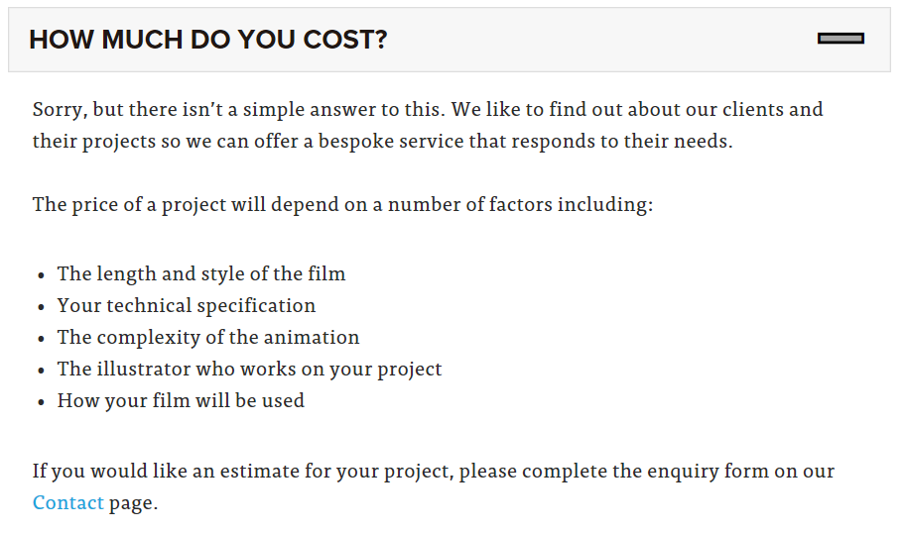
FAQs
Notes:
I tried to research how much it cost to produce this video and it appears to be commercially sensitive. They would have had to employ a whole range of specialists. Storyboarders, animators, illustrators, video editors etc.

Slide 6
Estimated Cost
£8000 per minute of video
11 minutes 40 seconds long = £92,800
Notes:
I did a general search and found an estimate for the commercial production for these types of animated film. Obviously this is way outside the limits of our budget!

Slide 7
Notes:
However, I have made my own version of this film. I produced it to support the teacher trainees with their first assignment.

Slide 8
Outcomes
Student cohort = 170
Views = 591
Reduction in assignment failure rate
Notes:
A range of interventions have been put in place to support the students, so the increased pass rate cannot be exclusively attributed to this movie.

Slide 9
So, How Did I Do It?
Write the script.
Record a voiceover.
Create a storyboard.
Create the pictures.
Animate the images in time with the voiceover.
Direct the focus on the key points in the story.
Create a video.
Upload to YouTube.
Share the link.
Notes:
I had to work through the whole sequence.
I produced the script to start with as the content is the most important component of the movie.
I recorded a voice-over and then proceeded to animate it. I am not very good at art and do not have good drawing skills

Slide 10
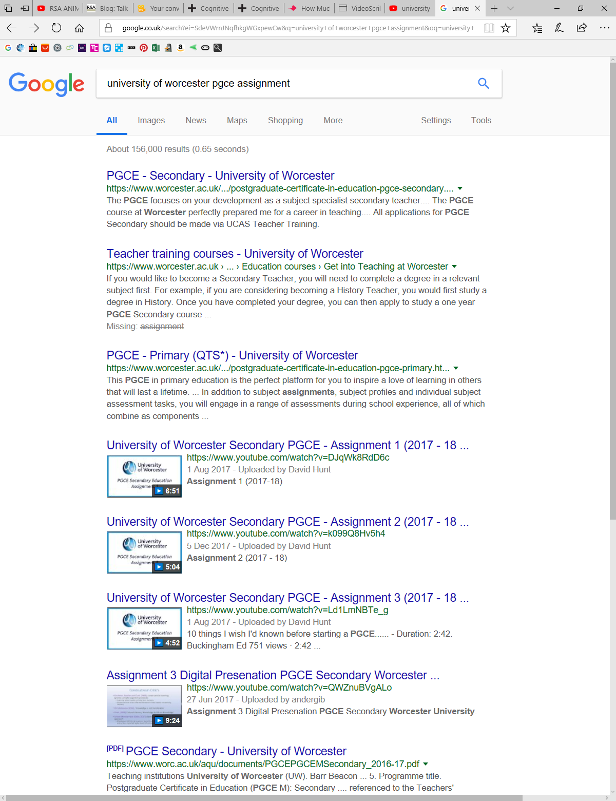
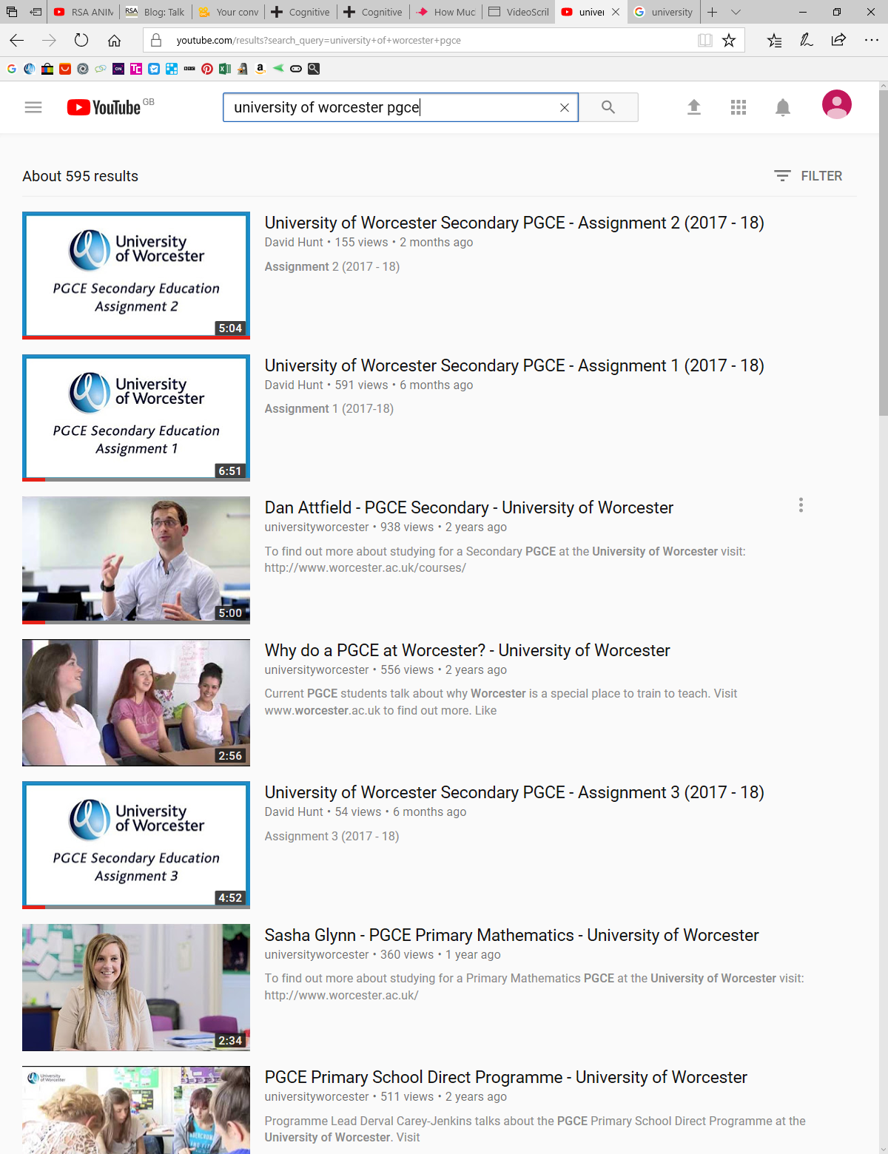
Google Search
YouTube Search
Notes:
There are some spin-off benefits. UW now appears on the first page of Google searches for assignments.
This would cost a fortune if a Search Engine Optimisation strategy had been implemented.
The YouTube viewing figures show 3 of the top 5 returns for UW.
These can now reach a global audience.

Slide 11
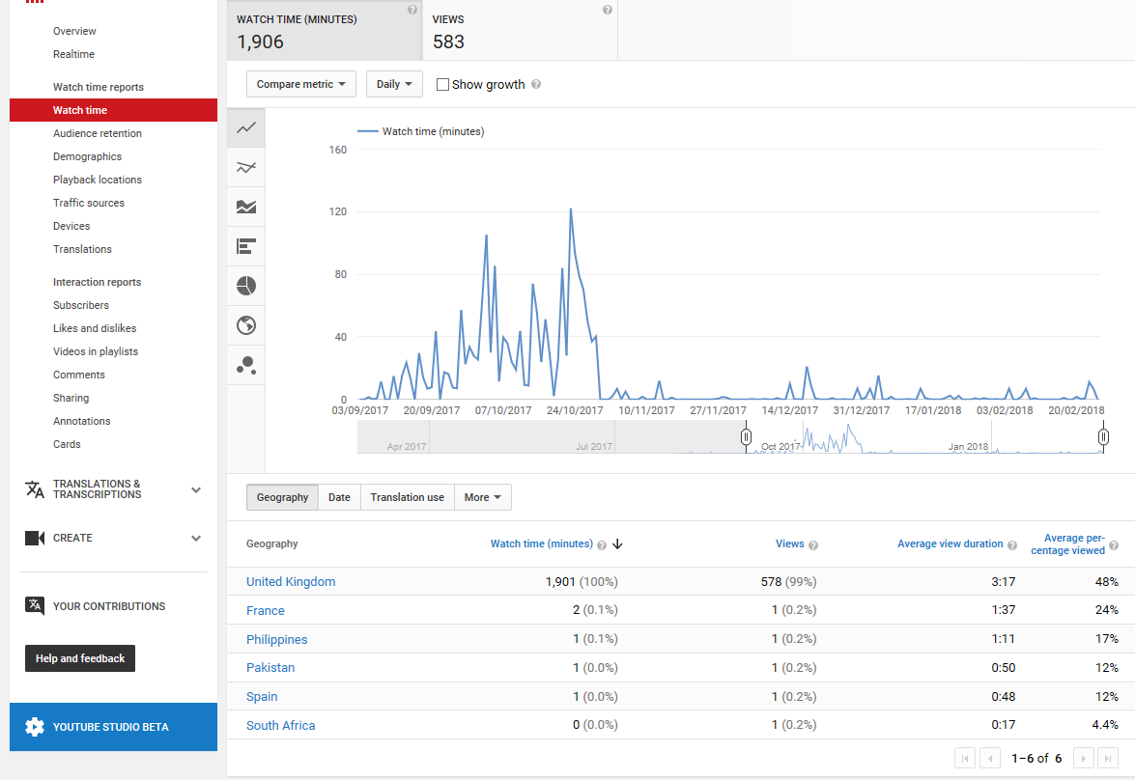
Google Analytics
Notes:
It is possible to use Google Analytics to review the viewing figures of each movie. The average viewing time can be seen as well as the dates the movies are viewed (quite close to the deadline date!)

Slide 12
White Paper - Sage Publishing
Key Findings:-
Shorter videos are preferable to longer ones.
Median engagement time was 6 minutes at most, regardless of video length.
Contiguity principle. Multimedia materials are more effective when words/pictures occur in close proximity.
Carmichael, M., Reid, A. & Karpicke, J. (2018) Assessing the Impact of Educational Video on
Student Engagement, Critical Thinking and Learning: The Current State of Play. Available at
https://us.sagepub.com/sites/default/files/hevideolearning.pdf (Accessed: 27 February 2018).
Notes:
This interesting White Paper has just been published by Sage Publishing. The key findings are listed here and are relevant to the production of these movies.

Slide 13
Partnership Student Comments
I just love those videos. When I watch them, I can hear you speaking to us (even though it is not your voice). It reminds me of the salient points you discussed when you introduced the assignment.
PHHS SCITT
The videos are Fab! I watch them, take a screenshot, do my writing and then work through the next bit.
Devon SCITT
Notes:
These movies are also available to our partnership institutions. It is interesting that students identify with them, even though they have never met the tutor who did the voice-over.

