Slide 1
Improving guidance for students on module choice
Oran Devilly & Lesley Spiers
Updates : 2017-18

Slide 2
Recap
Academic support identified as an area for improvement, with a significant number of courses scoring poorly in relation to communication, information and guidance concerning module choices.
Project Aimed to:
Identify issues in this area
Review existing sources / systems of information and guidance
Identify the kind of information and guidance students would like
Improve student satisfaction through recommendations

Slide 3
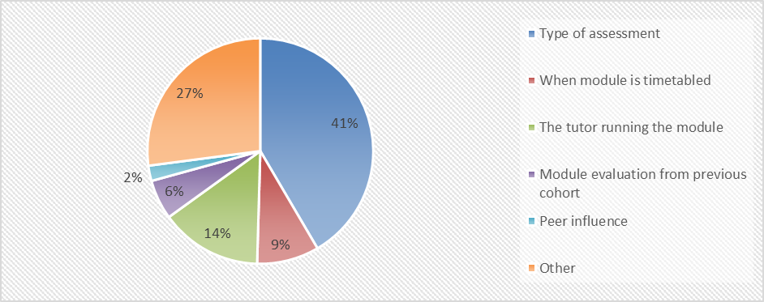
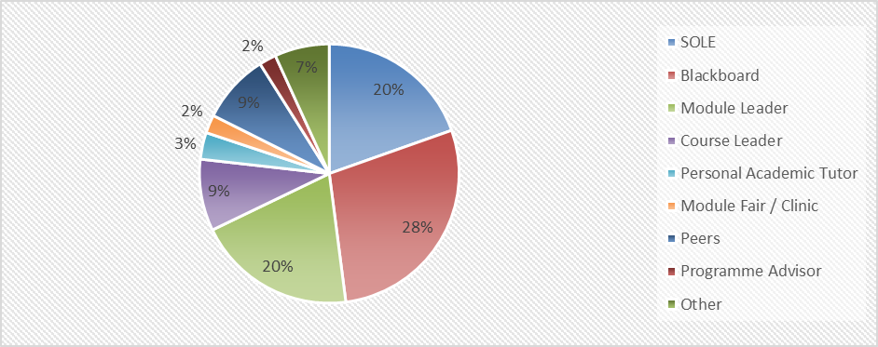
Data Collected from student representatives
Which of the following is most important when making module choice:
Who or what is your first point of contact when looking for module information:

Slide 4
Recommendations
Ensuring information accuracy:
concise and up-to-date information about modules is provided
Module Leaders should be asked to ensure the information on SOLE is accurate in a timely manner before the module selection process
Ensure Module Leaders / Associate Lecturers and any involved staff with modules are comfortable giving appropriate advice to students or know where they can direct a student for more course specific vs module specific advice
Ensure that students are informed about their choices not least on how to access information and providing clear guidance on which modules to select – particularly imperative for Joint Students.
How to provide information on modules:
Module fairs versus alternatives?
Consider start dates for module selection process
Module descriptions & Module Directory

Slide 5
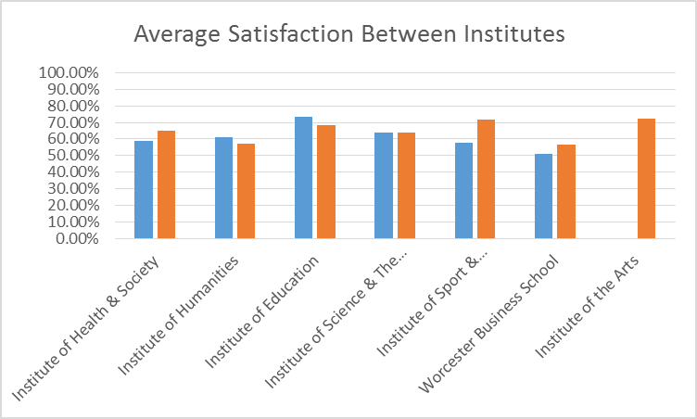
Result Comparison from last year
2017
2018

Slide 6
Further Issues
Total Average Satisfaction up from 61% to 65% over last year
Potential Continued Issues:
It was observed in Worcester Business School that when the module selection process opened, only language modules were available to students.
Starting date for module selection was during a holiday period, results in less staff availability and students ‘stewing’ on issues until they return after the holiday period
Still a very mixed experience for students in terms of being given clear advise on module choice
Courses in Advertising, Animation, fine Art, Foundation Degree (Mental Health), Learning Support (Foundation), Mathematics, Media and Culture all with 100%
A larger number of courses below 75%
19 of those courses lower than 50%

