Slide 1
Developing a Tool for Observations in Higher Education Teaching: Can one size fit all?
Catriona Robinson (Deputy Head, School of Education)
Lerverne Barber (Deputy Head, School of Sport and Exercise Science)
EDULEARN18
2nd July ’18

Slide 2
Aims:
To provide an overview of the context, place and purpose of teaching observations in Higher Education in England;
To explore the tensions in using a single observation tool for multiple purposes;
To explain the observation tool developmental process and initial outcomes.

Slide 3
Department for Education (2017)
Notes:
Explain introduction of TEF with a focus on teaching quality (and other metrics). Questionable and contentious that these measure teaching quality but we don't have time to discuss here.

Slide 4
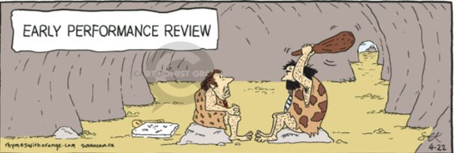
Purpose of observations
Probation
Peer observation (Thomson et al 2015)
Professional development
Recognition and reward
Measuring teaching quality (Gibbs 2016)
Performance management
Notes:
Perhaps enquire of the audience how they use observations?

Slide 5
What does the research say?
"If we make the connections...between teaching improvement and observations and resist the assumptions that observations are about making judgements, then we have a mindset conducive to creating and valuing observation systems that engage and work....[separating] the observation process from the system of appraisal." Compton 2016

Slide 6
Observation tool
Professional development
Performance management
The dichotomy of dual purpose
Notes:
Set context re performance management and existing observation tool designed by HR.
Additionally there were a plethora of different forms for observation and nothing with teeth for managing performance or anything to indicate performance levels to those wishing to apply for rewards and recognition
Outline the dichotomy

Slide 7
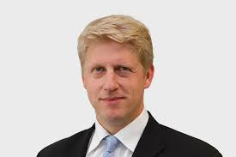
"This patchiness in the student experience within and between institutions cannot continue. There is extraordinary teaching that deserves greater recognition. And there is lamentable teaching that must be driven out of our system." Jo Johnson (Universities Minister 9th September 2015)

Slide 8
So what did we do?
Initial discussions internally with Academic Quality and Human Resources
Review of the landscape nationally and internationally
Mapping of the University of Worcester Teaching and Learning domains and UK Professional Standards Framework

Slide 9
Context
University of Worcester Teaching and Learning Domains
1
UK Professional Standards Framework (UKPSF) (HEA 2011)
2
Teaching Excellence Framework (TEF)
3
Notes:
Give out hard copies of each document

Slide 10
Feedback from staff
It needs to not be too onerous;
Staff completing the observation paperwork need to have training to ensure consistency and a shared understanding;
Staff could see the value of only having one tool, however, there are challenges with this too;
Staff need to be familiar with the UKPSF framework.
Notes:
11 versions all together and a year of piloting etc.

Slide 11
Response to feedback
Initial trial for performance management purposes
Staff development workshops
Probationary period pilot
Professional development pilot

Slide 12
Next steps
Adoption by Human Resources (HR)
Gain ethical approval
Establish focus groups
Conduct interviews
Glean participant perceptions from observers and those being observed
Measure impact e.g. increase in HEA Fellow, improved teaching quality
Publish outcomes

Slide 13
References
Compton, M., (2016) The Role of Teaching Observations: Developing or Managing Academic Practice? Journal of Learning and Teaching, 8(12).
Department for Education (2017) Teaching Excellence and Student Outcomes Framework Specification, Crown copyright, reference: DFE-00272-2017. Available at:
https://assets.publishing.service.gov.uk/government/uploads/system/uploads/attachment_data/file/658490/Teaching_Excellence_and_Student_Outcomes_Framework_Specification.pdf
Gibbs, G. 2016. Teaching, in Response to the Higher Education Green Paper. Higher Education Policy Institute (HEPI Report 81). Oxford: Higher Education Policy Institute.
HEA (2011) The UK Professional Standards Framework for Teaching and Supporting Learning in Higher Education.
Thompson, K., Bell, A. and Hendry, G. (2015) Peer observation of teaching: the case for learning just by watching, Higher Education Research & Development Journal, Volume 34, Issue 5, pg1060 – 1062.

